Slide 1
Problem Analysis Report

Slide 2
Assessing Academic Pressure Among Students At FAST University
Waleed Malik (21L-5248)
Umamah Hussain (21L-1858)

Slide 3
Table of Contents
Introduction
Academic Pressure
Mental Well-being
Leisure time
Social Engagements
Balance between personal life and academic commitments
Academic Support Services
Conclusion
Yeahm

Slide 4
Introduction
Academic stress refers to the stress and expectations placed on university students to excel in their studies and meet various educational demands.
This stress can come from multiple sources, including professors, parents, peers, and self-imposed standards.
Academic stress is a prevalent issue affecting university students worldwide
What is Academic Stress?

Slide 5
Academic Pressure
Institutions should prioritize the delivery of high-quality education while considering how much academic pressure students can handle.
The efficacy of education is contingent upon students' ability to derive benefits without being overwhelmed.

Slide 6
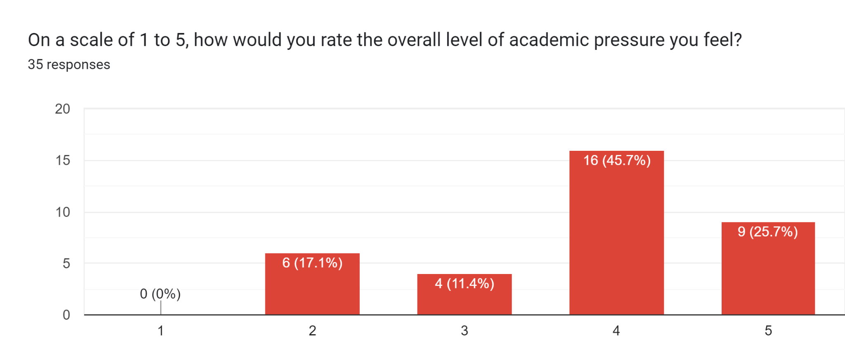
Statistics

Slide 7
Academic Pressure
It is imperative to cultivate an academic environment that fosters an enjoyable and intellectually stimulating learning experience.
References:
In a number of studies, authors found that the most frequently reported factors contributing to stress and anxiety in university students are:
extensive course loads
lack of physical exercise
long duration of exams
(Harikiran, 2021)

Slide 8
Mental Well-being
Ensuring the mental well-being of university students is paramount, especially in the face of academic stress.
The demanding nature of education at Fast university has significantly impacted students' mental health.

Slide 9
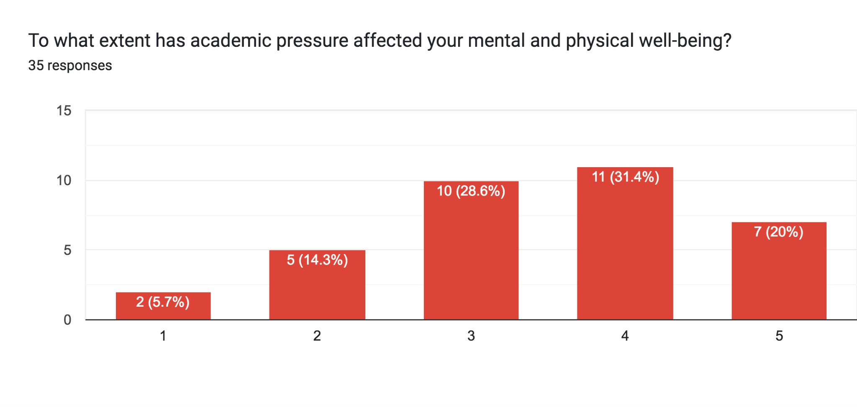
Statistics

Slide 10
Mental Well-being
Vital steps Fast university can take to mitigate the adverse effects of academic stress on mental health.
Implement mental health support systems
Stress management programs
Counseling services
Promote a healthy work-life balance
References:
Results from literature suggest higher level of stress to be associated with poor academic performance
(Sohail, 2022)

Slide 11
Leisure time
Leisure time is important in the lives of university students for relaxation, personal development, and self-expression.
Academic pressures frequently encroach upon this free time.
This limitation reduces students' opportunities to pursue personal hobbies and engage in leisure activities.

Slide 12
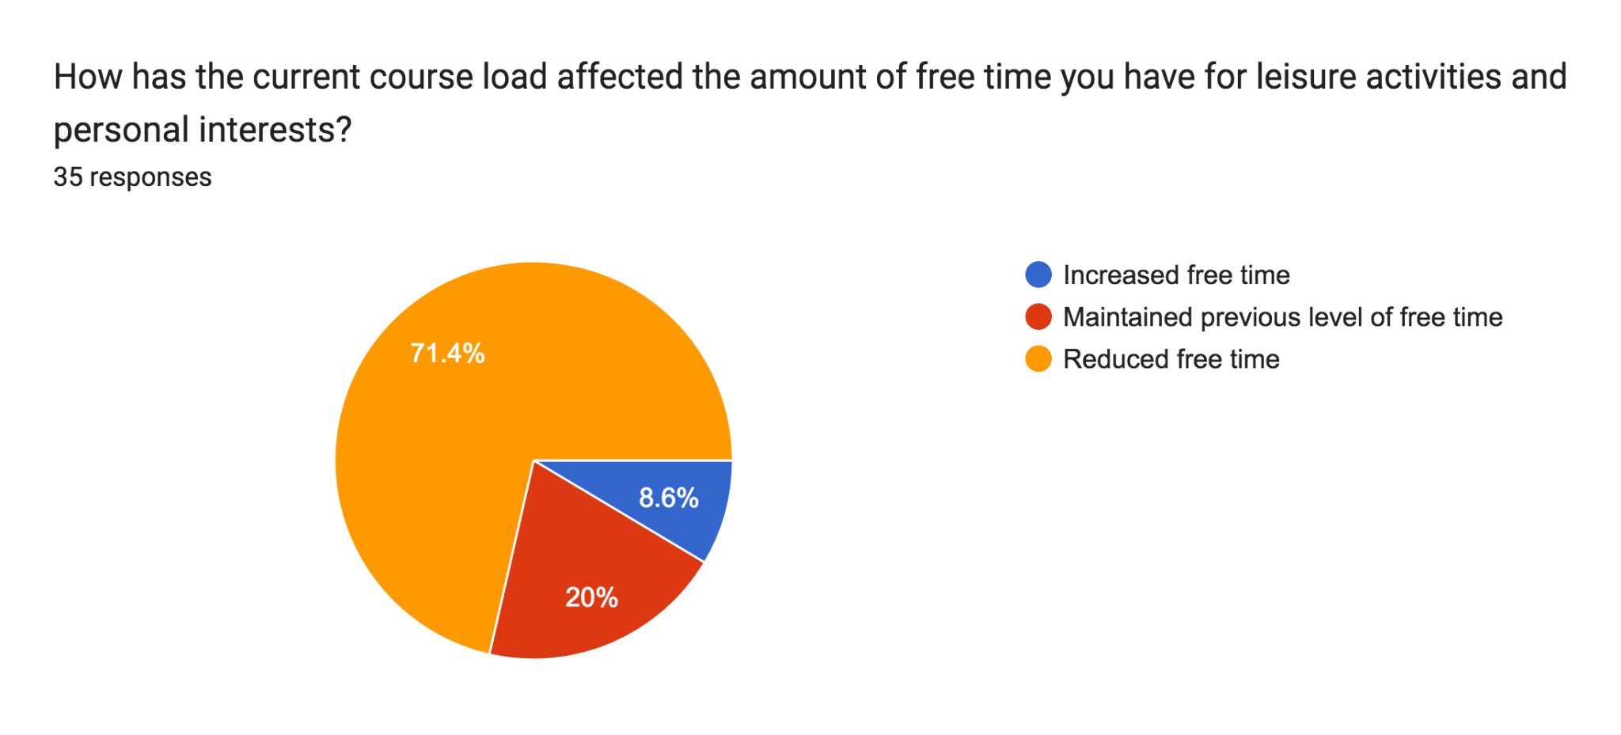
Statistics

Slide 13
Social Engagements
The university experience is more than just academics; it includes social interactions, friendships, and lasting relationships.
Academic pressure can significantly hinder students' participation in social activities and their ability to form meaningful connections with peers.

Slide 14
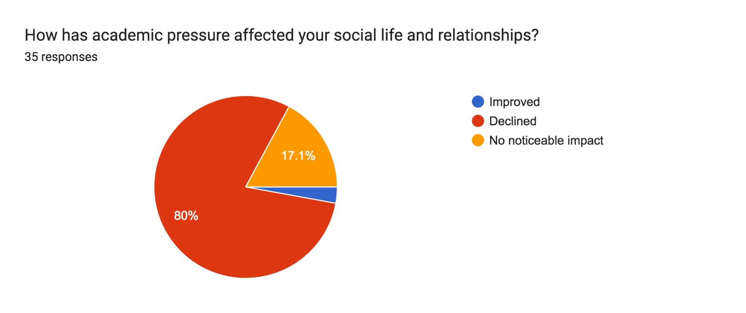
Statistics

Slide 15
Balance between personal life and academic commitments
Striking an equilibrium between personal life and academic responsibilities is challenging for university students.
Academic demands often encroach upon personal domains necessary for self-care, familial engagement, and participation in extracurricular activities.

Slide 16
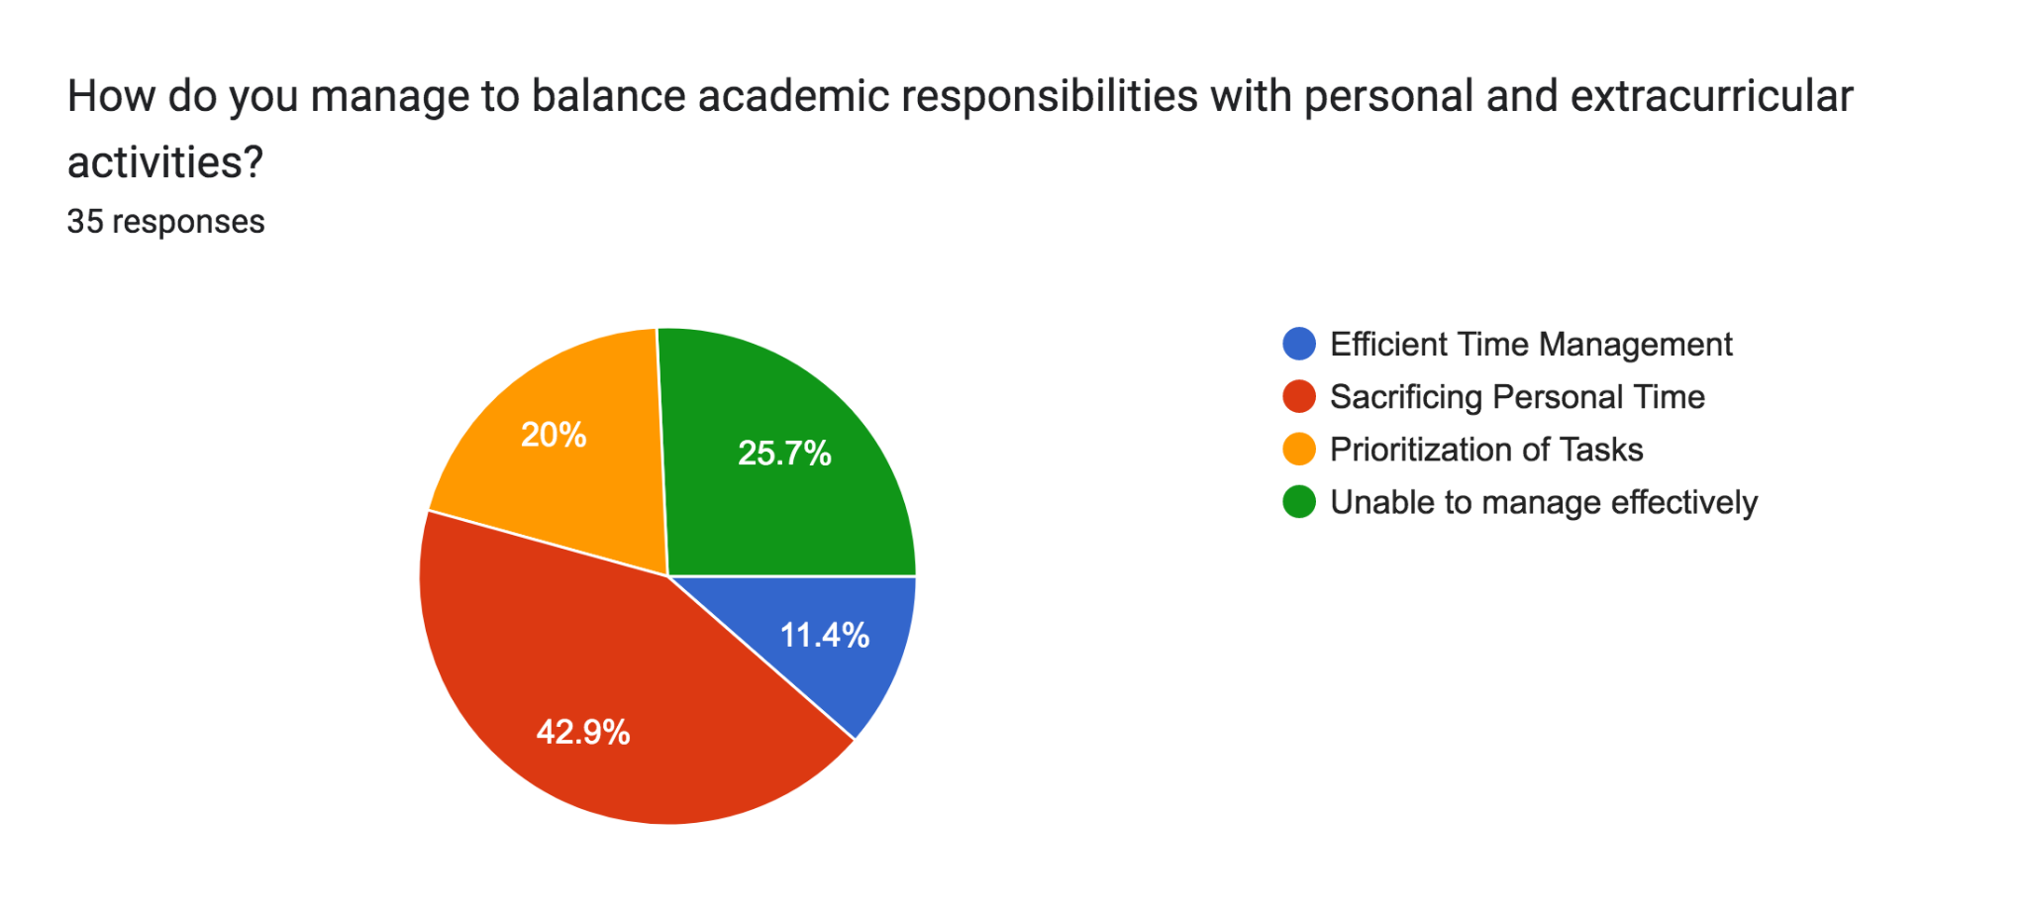
Statistics

Slide 17
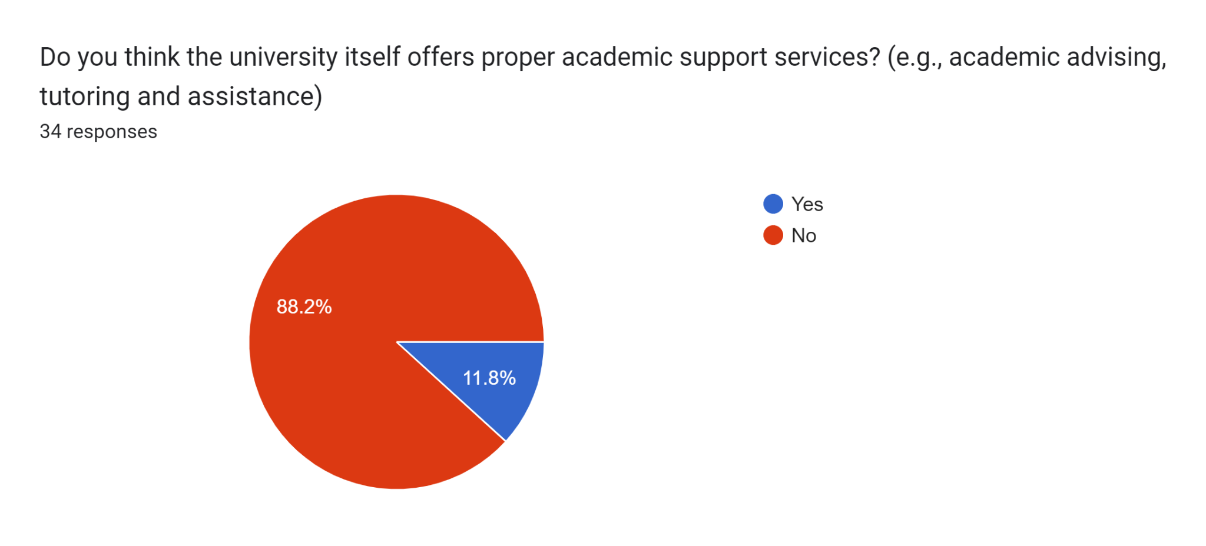
Academic Support Services

Slide 18
Academic Support Services
Addressing Individual Academic Needs
Academic Advising
Library and Research Support
Peer Tutoring/Mentorship Programs
Career Services
Online Learning Resources
Financial Aid and Scholarships Assistance
Feedback and Consultation Sessions
Health and Wellness Centers

Slide 19
Conclusion
Survey data highlights academic stress as a pervasive issue among university students at FAST-NU.
Academic pressure effects are far-reaching, affecting overall well-being, leisure time, social lives, and personal relationships.
It's crucial for the university to comprehensively address this issue and provide necessary support services.
Implementing suggested improvements can create a more favorable and supportive academic environment for students at Fast University.

Slide 20
References
Alborzkouh, P. N. (2021). A review of the effectiveness of stress management skills training on academic vitality and
psychological well-being of college students.
Harikiran, A. S. (2021). Perceived sources of stress amongst final year dental undergraduate students.
Bangalore: Indian Journal of Dental Research.
Sohail, N. (2022). Stress and academic performance among medical students. J Coll Physicians Surg Pak.

